Slide 1
CHRISTIAN ETHICS
Farmed Animal Welfare as a case study
Notes:
GENERAL INTRO NOTES:
This slide set is designed to offer the framework for an ethics module session, level 4/5, for Common Awards. Although it covers farmed animal welfare specifically, parts of it are also relevant to consideration of vegetarianism/veganism and climate-related issues.
It is blank in basic design to allow tutors to adapt it easily to their own template and incorporate their own material. The 2nd slide has an image you may wish to use faded as background.
All pixabay images are free to use under the Pixabay license (https://pixabay.com/service/terms/) but acknowledgements are welcomed. Others are copyrighted as noted. Alamy stock photos in this presentation may only be legally used within this slide set as an CEFAW Education publication. The broad structure of the topic is introduced using the framework of a Wesleyan Quadrilateral, with much content drawn specifically from the CEFAW Project.
For more material and to download the 62 page Policy Framework produced by the project, see https://www.abdn.ac.uk/sdhp/divinity-religious-studies/cefaw/resources-2140.php where there is also a 7 min video summarising the project which may provide a convenient introduction to the class.
Biblical quotations are from the NRSVA.
For Hub sources, please go into your Moodle and open a Hub page before using the links here.

Slide 2
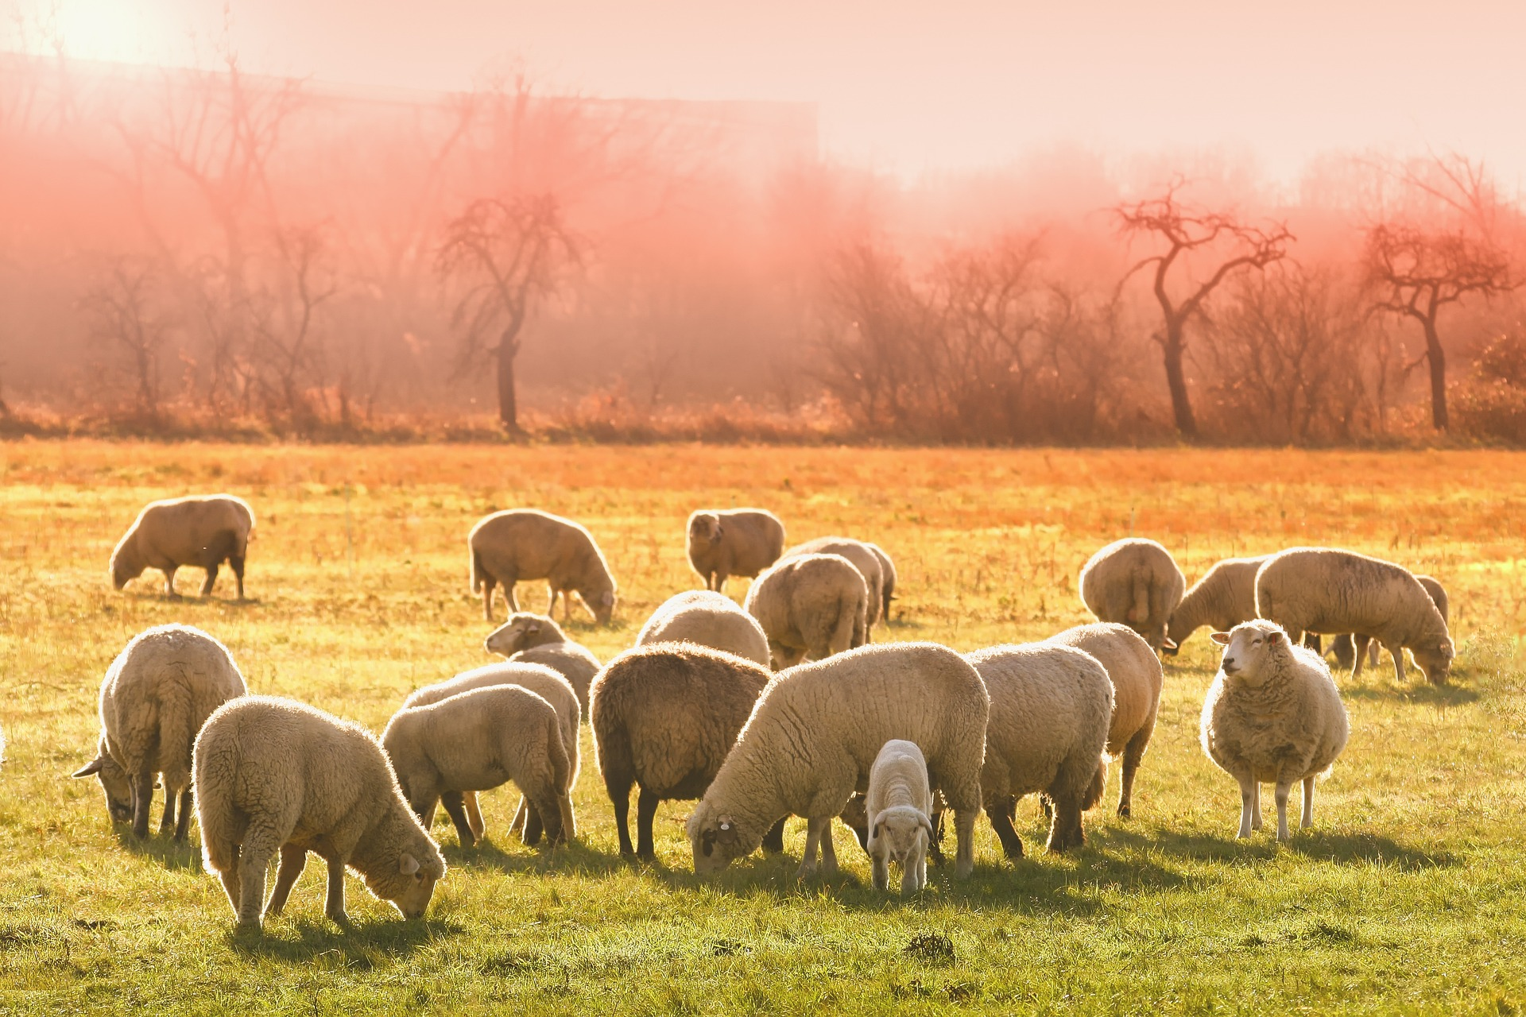
Image by Tom from Pixabay
Notes:
Image by Tom from Pixabay
You may wish to use this as another illustration or fade it to use as background.

Slide 3
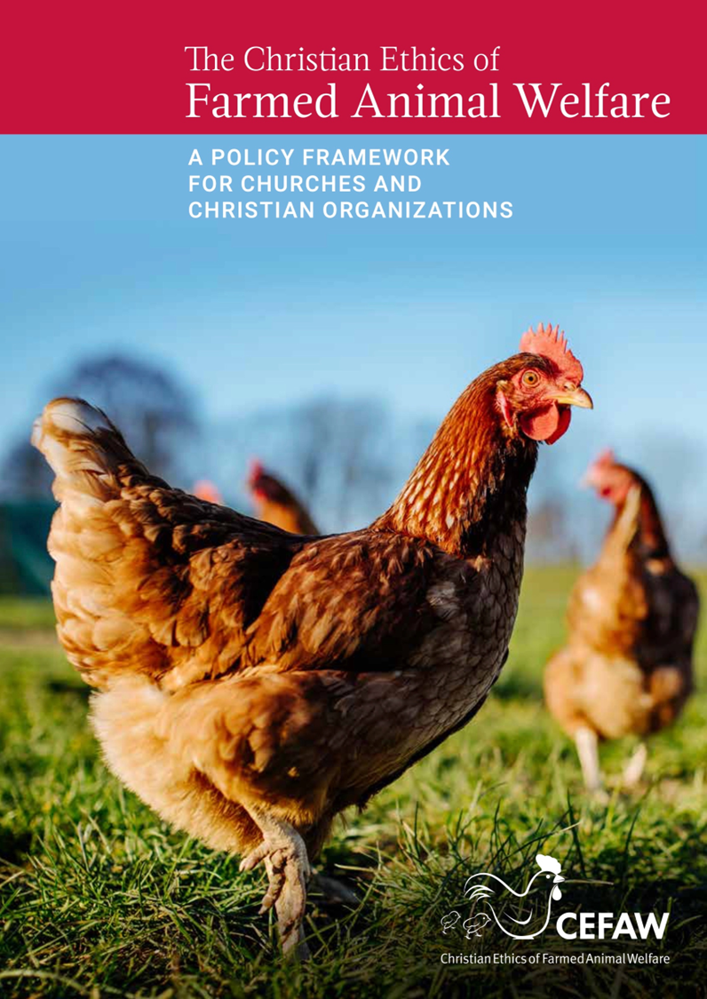

Project: The Christian Ethics of Farmed Animal Welfare
Policy Framework, 2020
Argues all creatures praise God in their flourishing
Evaluates current UK farming practices in light of flourishing
Notes:
This slide set is based around biblical, theological and farming data from this project, whose principal authors include both theologians with considerable experience in this field and a veterinarian. Discussions and input were also obtained from various partner organisations, including Church bodies (CoE, CoW, CoS, RC, Methodist and URC), and organizations concerned with animal welfare (see p61 of booklet, downloadable from here https://www.abdn.ac.uk/sdhp/divinity-religious-studies/cefaw/cefaw-policy-framework-2138.php).
The project is widely based, taking economic and technological issues into account.
The slide set is structured around the Wesleyan Quadrilateral and offers the project’s conclusions towards the end. It may be changed to suit the focus the user wishes to give but acknowledgement of the project and its logo should be retained.

Slide 4
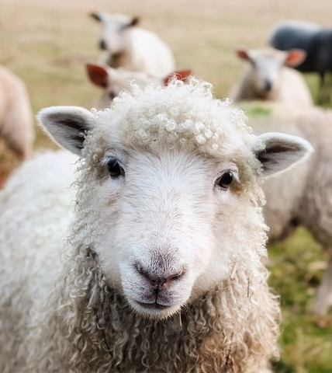
Why should Christians be concerned with this topic?
Christians eat farmed animals and their products
Christians believe in a God who wills the flourishing of all creatures
Farmed animals, like wild animals, are creatures of God, and together comprise 24 x mass of all wild animals
This is tied up with other important issues such as carbon footprint/climate crisis
Image by David Mark from Pixabay
Notes:
All Christians eat and many eat animal products from farmed animals; eating together is an important part of Christian practice.
Creaturely flourishing matters in Christian theology; God creates and sustains all creatures so all share the creaturely purpose of glorifying God in their flourishing.
There is evidence that some farming practices result in less than good treatment of animals, or even in poor conditions where they cannot flourish.
Image by David Mark from Pixabay

Slide 5
Biblical themes concerning non-human creation
God creates all creatures
All creation praising God
God’s covenant with all creatures
Humanity’s relationship with the rest of Creation
Notes:
Firstly, we consider some biblical resources for reflection on this topic.

Slide 6
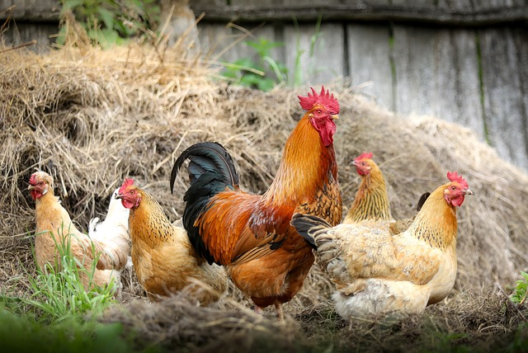
Biblical texts
Creation is God’s and is very good (Gen 1)
God continues to sustain all creatures (Ps 84.3; 104; Matt 10.29)
Creation responds to God (Ps 65.12-13)
All creation is called to praise God (Ps 96.11-12; 103.22; 148)
Image by svklimkin from Pixabay
Notes:
Just some of the possible general examples given here.
See also (for level 5) Richard Bauckham (2002) ‘Joining Creation’s Praise of God.’ Ecotheology 7:45-59.

Slide 7
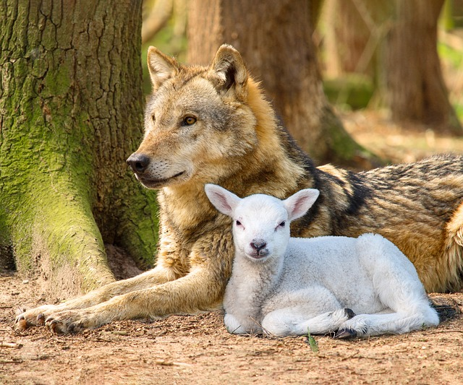
Biblical texts
Following the flood, God makes a covenant with ‘every living creature of all flesh that is on the earth’ (Gen 9.9-17)
Indications of inclusion of the rest of Creation in God’s redemptive project (Isa 11.1-9; 65.17-25; Rom 8.18-23; Col 1.15-20; Rev 5.13)
Humanity has responsibility towards the rest of Creation (Gen 1.26-28; Ps 8.6-8): differing interpretations of ‘subdue’ and ‘have dominion’
Guidelines for treatment of domestic animals (Deut 5.14; 25.4)
Image by Sheri McFarland from Pixabay
Notes:
God is concerned with more than the human.
For levels 5 upwards, see CEFAW annotated reading list on the debate around ‘subdue and have dominion’ which is on Hub Plus. Briefly, some (e.g. Habel) argue the language is inescapably hierarchical and implies the use of force/exploitation. Others (e.g. Bauckham) suggest the dominion should be of the same kind as God’s (i.e. caring, supporting – see Eze 24.4 for the things it should include) and that ‘subdue’ applies to the land and should be translated ‘occupy’ or ‘take possession’.
Domestic animals – see next slides for more.
Image by Sheri McFarland from Pixabay

Slide 8
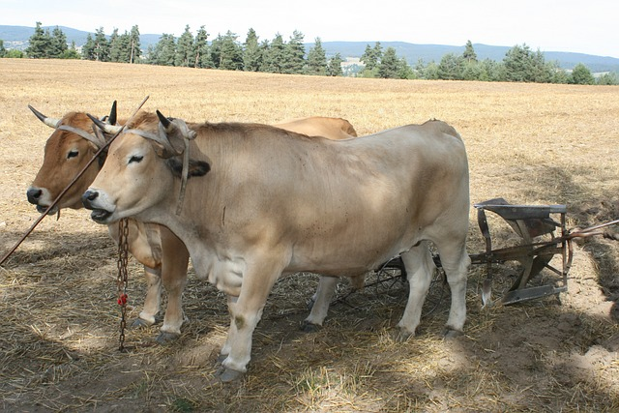
Treatment of livestock– what should it look like?
‘Be fruitful and multiply’ Gen 1.22; 8.17
Livestock to rest on sabbath (Exo 23.12; Deut 4.14)
Prov 12.10 ‘The righteous know the needs of their animals’
‘ You shall not muzzle an ox while it is treading out the grain.’ Deut 25.4 (but see 1 Cor 9.9)
Care expected from humans, not just their owners (Luke 13.15; 14.5)
Image by CLAUDINE BARGETON from Pixabay
Notes:
Animals should be enabled to flourish in terms of reproduction of their kind.
Domestic animals should not be over-worked, should be fed and generally well-treated.
Image by CLAUDINE BARGETON from Pixabay

Slide 9
Livestock
Eschatological images
  ‘Happy will you be who sow beside every stream, who let the ox and the donkey range freely.’ (Isa 32.20)
  ‘On that day your cattle will graze in broad pastures; and the oxen and donkeys that till the ground will eat silage, which has been winnowed with shovel and fork.’ (Isa 30.23-4)
Notes:
Images of eschatological flourishing of all creatures include some featuring livestock.

Slide 10
Treatment of livestock for sacrifice
‘When an ox or a sheep or a goat is born, it shall remain for seven days with its mother, and from the eighth day onwards it shall be acceptable as the Lord’s offering by fire. But you shall not slaughter, from the herd or the flock, an animal with its young on the same day.’ (Lev 22.27-8; see also Exo 22.30 and Deut 15.19)
Notes:
Used in sacrifice but limitation on separating first-born calf from mother.

Slide 11
What contribution do these texts, and others like them, make to our ethical reflection on the treatment of farm animals?
Why should Christians be concerned with this topic?
Image by David Mark from Pixabay
Notes:
Image by David Mark from Pixabay

Slide 12
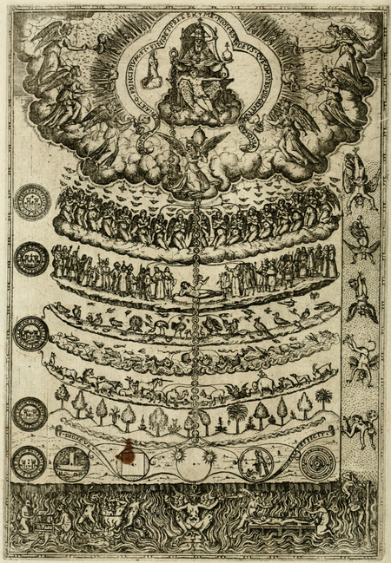
Christian Tradition
Greek influence: human as different from other creatures because ‘rational’
Historically, Christian theology anthropocentric in scope and interest
Human creation seen as climax of creation; human redemption as goal of new creation
Chain or ladder of being; ascending towards God
https://en.wikipedia.org/wiki/Great_chain_of_being
Notes:
For levels 5 upwards, see Ch 3 of Clough, David L. On Animals: Volume I: Systematic Theology: 1 (London & New York: T&T Clark, 2011) On Hub

Slide 13
Christian Tradition
Vast chain of being! which from God began,
Natures aethereal, human, angel, man,
Beast, bird, fish, insect, what no eye can see,
No glass can reach; from Infinite to thee,
From thee to nothing. … Alexander Pope
Debate on what distinguishes human beings from other animals
https://en.wikipedia.org/wiki/Great_chain_of_being
Notes:
See Ch 3 of Clough, David L. On Animals: Volume I: Systematic Theology: 1 (London & New York: T&T Clark, 2011) p48 of e-book, quoting Alexander Pope, ‘Essay on Man’, VIII, cited in Lovejoy, Great Chain of Being, 60.

Slide 14
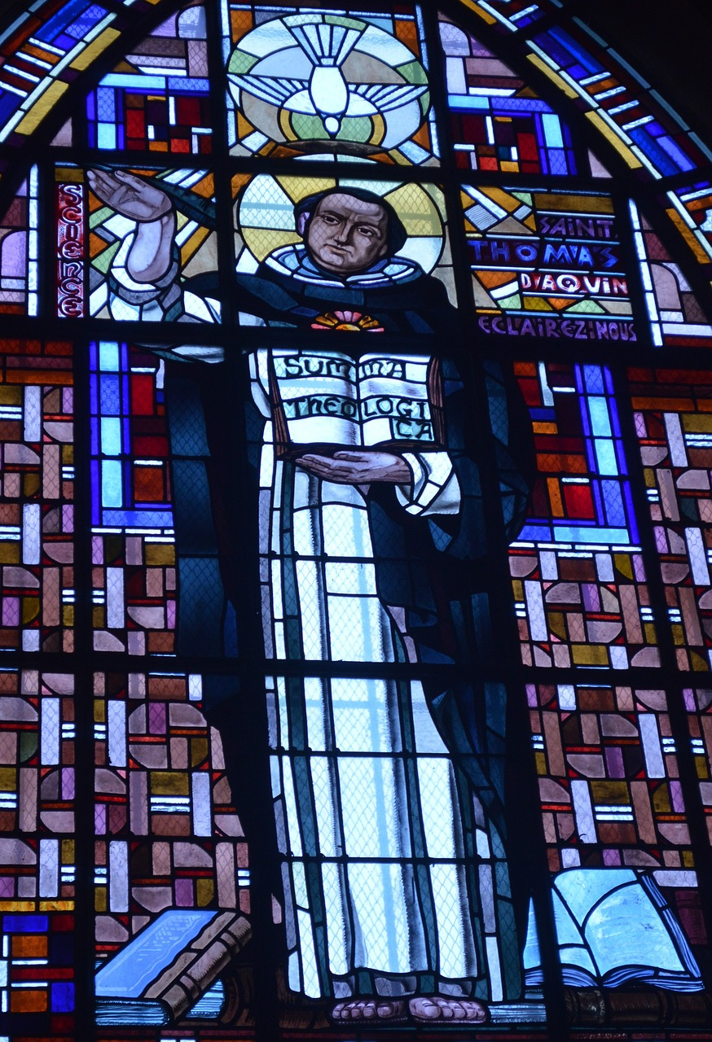
Christian Tradition
‘For Aquinas, … the Genesis 1 creation narrative can only be read as affirming that the diversity of creatures is a deliberate choice by God in order to make creation more perfect than it would be if it only contained one kind of creature or fewer kinds of creatures.’
Calvin inferred that the purpose of creatures being created ‘was that “none of the conveniences and necessaries of life might be wanting” to human beings’.
Clough, 2011
Image by Dorothée QUENNESSON from Pixabay
Notes:
See Ch 3 of Clough, David L. On Animals: Volume I: Systematic Theology: 1 (London & New York: T&T Clark, 2011) p44 of e-book (Aquinas) and pp19-20 [citing John Calvin Genesis ed. and trans. John King, (Edinburgh: Banner of Truth Trust, 1965) p96]
Image by Dorothée QUENNESSON from Pixabay

Slide 15
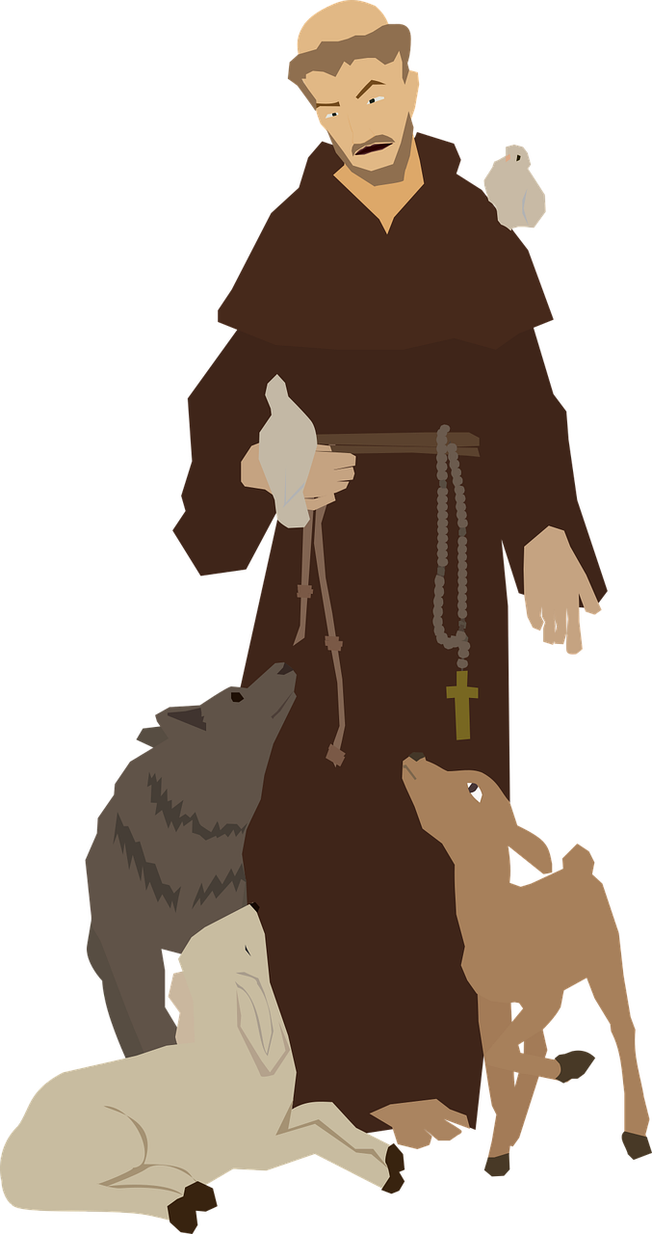
Christian Tradition
Stories of Christian saints’ interactions with animals suggest a theme of ‘holy dominion’
e.g. St Francis argues for care beyond providing needs
John Wesley against cruel treatment
Historically, concern for animal welfare arising from within Christian tradition e.g. RSPCA
Miyoko Goto from Pixabay
Notes:
For other stories of saints: ‘Many stories of the saints feature miraculous interactions with animals, reflecting extraordinary relationships of holy dominion. St Modestos healed working oxen; St Melangel stopped hunting dogs in their tracks and protected the hares; St Anthony preached to the fish (and they listened); and St Francis argued that responsibility for animals exceeds protecting them from harm to include caring for their every need.’ ( Policy Framework p.8 )
(St Walstan is the patron saint of farm workers and farm animals. https://www.stwalstans.com/)
Wesley – see Clough, David L., ‘The Bible and Animal Theology’, in The Oxford Handbook of the Bible and Ecology, edited by Hilary Marlow, and Mark Harris, 401-12. Oxford: Oxford University Press, 2022, pp.402, 405-6. Hub e-book at https://hub.commonawards.org/blocks/configurable_reports/viewreport.php?id=40&filter_var=9780190606749
RSPCA see p48 in Hub e-book of Clough’s On Animals Vol 2: Theological Ethics:
‘It is notable that Christians were active in the first efforts to improve the welfare of farmed animals through legal regulation. The first anti-cruelty legislation globally was enacted in England in 1822, with broad support from London clergy and magistrates, as a result of widespread concern over how horses, cows, oxen and sheep were being treated by their handlers. Two years later, the Society for the Prevention of Cruelty to Animals (later the RSPCA) was established at a meeting including Richard Martin, the drafter of the 1822 bill and otherwise known as ‘Humanity Dick’, the Quaker Fowell Buxton, the Anglican vicar Revd Arthur Broome, the evangelical William Wilberforce, who had been active in the campaign to legislate against the British slave trade, and Lewis Gompertz, a prominent Jew.¹⁵⁹ In the twentieth century, it was the Quaker Ruth Harrison’s 1964 book Animal Machines¹⁶⁰ that gained renewed public attention to farmed animal welfare, and led to the UK government’s commissioning of the Brambell Report, published in 1965, which investigated the intensive farming of animals.’
For higher levels see CEFAW Historical British Animal Theology Reader under Hub Plus
Miyoko Goto from Pixabay

Slide 16
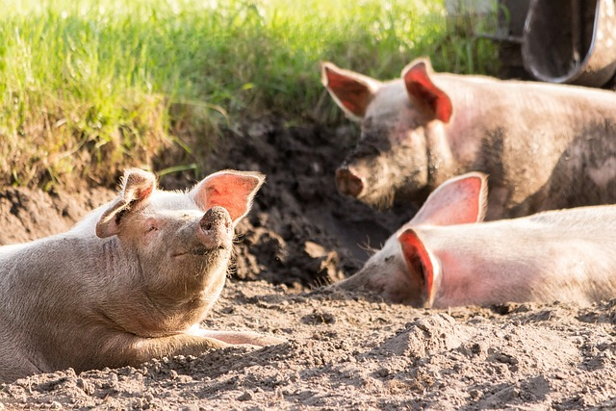
Contemporary reflection: Creaturely Flourishing in CEFAW Policy Framework p6:
‘The interpretation of scripture and Christian teaching in this framework presents all creatures — humans and animals — as created by God to flourish in praise together.’
Image by Michael Strobel from Pixabay
Image by Michael Strobel from Pixabay
Notes:
See Policy Framework p.6
Image by Michael Strobel from Pixabay

Slide 17
Creaturely Flourishing as giving glory to God: CEFAW policy p13:
‘Farmed animals praise God by living out their particular species- and individual-specific abilities, activities, relationships, and characteristics. … conditions that deprive or inhibit farmed animals from living in their species-specific particularity are conditions that deprive or inhibit their flourishing. To flourish, farm animals do not simply need to be protected from possible harm; flourishing prioritizes the well-being of animals on the terms of their identity as particular animals.’
Notes:
e.g. poultry dust-bathing, pigs rooting, etc see p22 of CEFAW Policy Framework
For higher levels of study, see further material below:
On Hub Clough - On Animals: Systematic Theology p83 ‘The biblical view, evident in Genesis 9 and other texts such as Job 38–41 and Psalm 104, is that each creature has been given its place within God’s creation and the Genesis 9 covenant is an expression of a divine expectation that creatures will live within the boundaries God has established for them. ‘
112 ‘For now, humans should seek to live in a way that reflects God’s gracious purposes to all creatures, on the grounds that they are a species uniquely capable of taking a view as to what might lead to the flourishing of other creatures; in the new creation, humans will be able to set aside this responsibility and join with other creatures in the praises of the lamb (Rev. 4.1–5.14).’
118 ‘Given that God did not merely establish the world for our own convenience, but wills the flourishing of all God’s creatures, we must ask what this might this mean for the appropriateness of Christian uses of other animals for food, clothing, labour, research, entertainment, companions and for our responsibilities to non-human animals that live beyond relationships of domestication. ‘
On Hub Clough On Animals: Ethics p23 ‘Once we have recognized other animals as fellow creatures that glorify God in their flourishing, fellow beneficiaries of God’s work of reconciling all things in Jesus Christ, and fellow participants in the new creation, we cannot be complacent about causing them to suffer. It may be justifiable to cause suffering to a non-human animal – for example, to give an injection that benefits the animal – but it must be justifiable to do so, i.e. there must be some justifying reason’

Slide 18
Why should Christians be concerned with this topic?
How might the different voices, across the Christian tradition, contribute towards our reflections on contemporary practices?
Image by David Mark from Pixabay

Slide 19
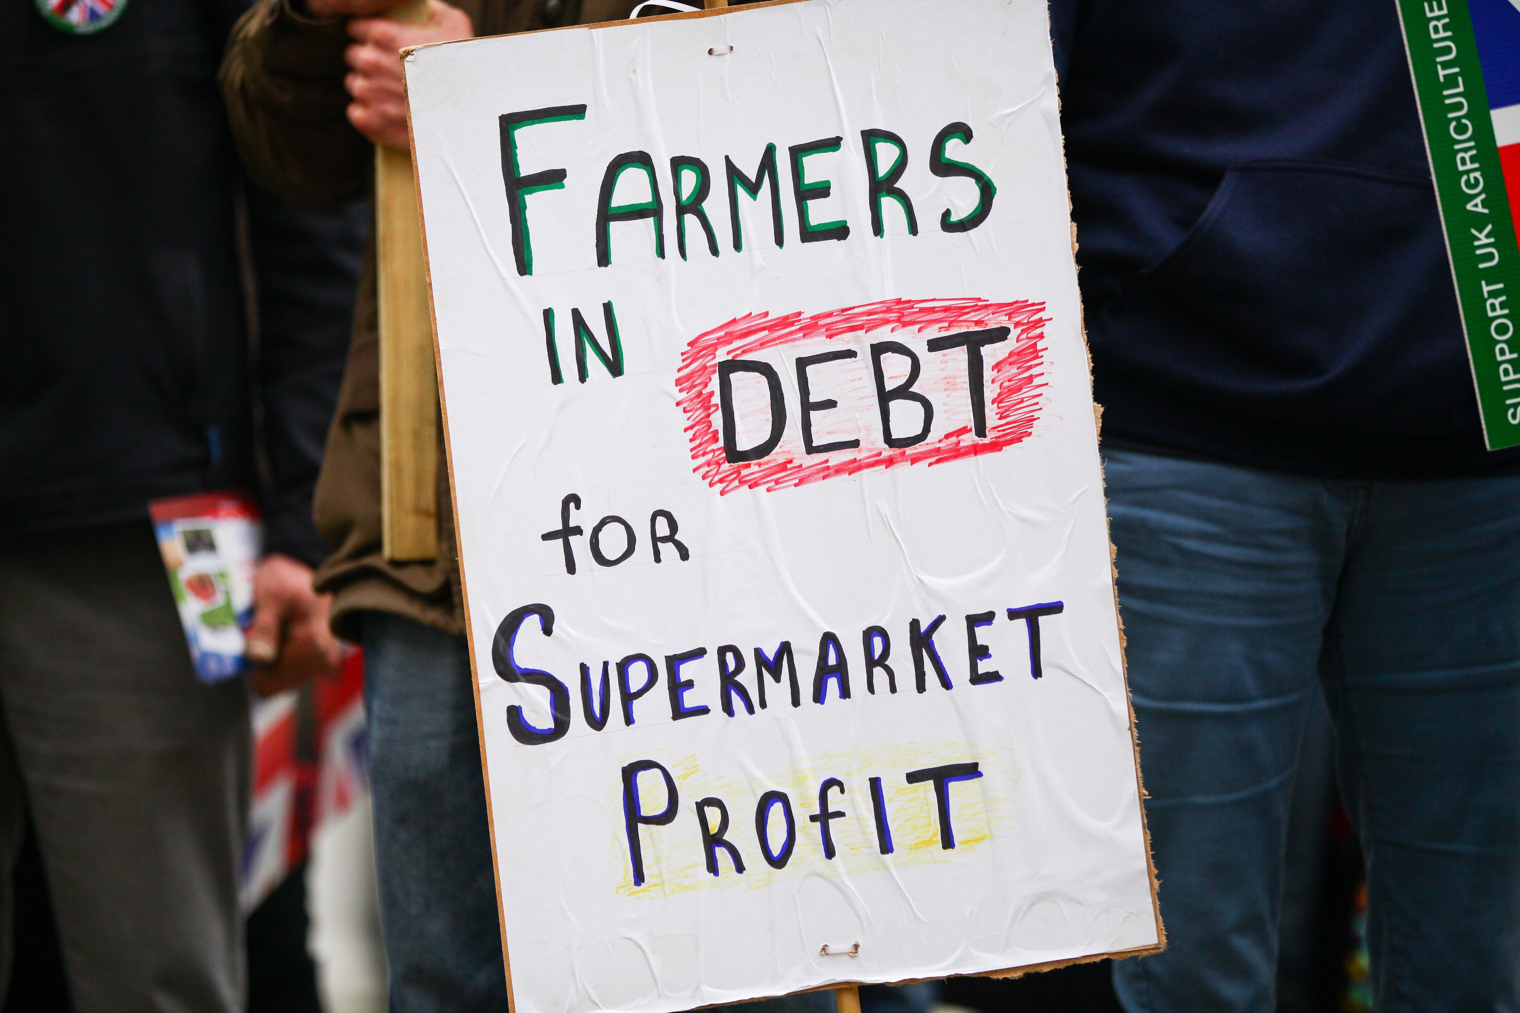
Reason – economic pressures on food production
Need for sufficient food for growing populations
Consumer demand & waste
Delivery chains and profit margins
Financial pressures on farmers
May be seen as systemic sin
Dinendra Haria / Alamy Stock Photo
Notes:
See Policy Framework pp. 8-9 for outline of economic issues
IMAGE COPYRIGHTED AS NOTED ABOVE – Alamy stock photos in this presentation may only be legally used within CEFAW Education publications.
CEFAW image Farmers debt markets profit sign IMAGE COPYRIGHTED AS NOTED ABOVE

Slide 20
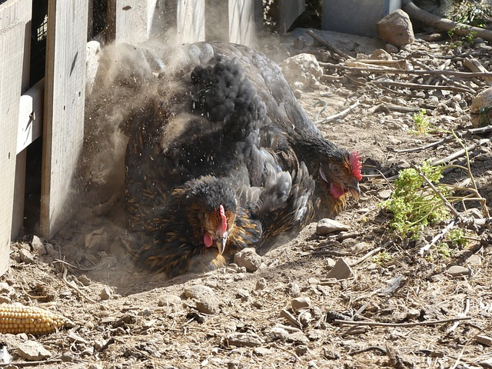
Reason – economically favourable farming practices that undermine animal flourishing
Monotonous environment: lack of space or opportunity to exhibit species-specific behaviours e.g. dust-bathing
Animal mutilations: castration, tail-docking, beak-trimming
Notes:
Pressures from factors above lead to pressures on farming practices: Drawing on Part 3 of CEFAW Policy Framework
lack of freedom to express species-specific behaviours e.g. poultry dustbathing (see p22 of Framework)
Castration, tail docking, beak trimming, dehorning may enhance negative freedoms, reduce harm (from fighting etc) but can reduce positive freedoms such as typical behaviour such as mating,
Image is of a chicken dust-bathing. Image by usd-susanne from Pixabay

Slide 21
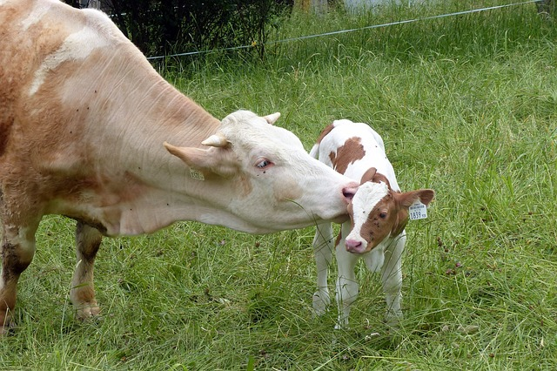
Reason – economically favourable farming practices that undermine animal flourishing
Break up of natural bonding relationships; e.g. calves removed from mothers, (When is least stressful to do this?)
Shortened lifespan – killed early in natural lifespan
Selective breeding for commercial purposes - may produce animals who suffer
Image by Alois Grundner from Pixabay
Notes:
Pressures from factors above lead to pressures on farming practices: Drawing on Part 3 of CEFAW Policy Framework
Eggs, calves, removed from mothers. Can reduce disease spreading – and some argue removing calves immediately after birth is less stressful than some weeks later – but prevents positive freedoms of parent/offspring bonding
Care on farm leads to negative freedom of not dying from disease but many animals killed after only living fraction of their lifespan and therefore curb flourishing.
e.g. bred for body mass but legs struggle to carry the body mass. Viewed as economic units
Image by Alois Grundner from Pixabay

Slide 22
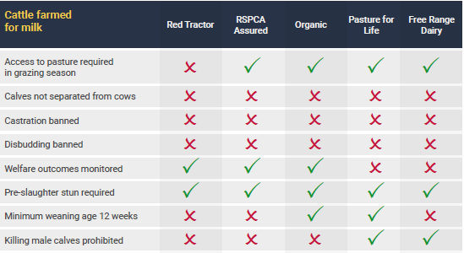
Reason – possible to select food for some factors:
Notes:
Policy Framework p50. Other tables for other species in Part 3, pp.18-51.

Slide 23
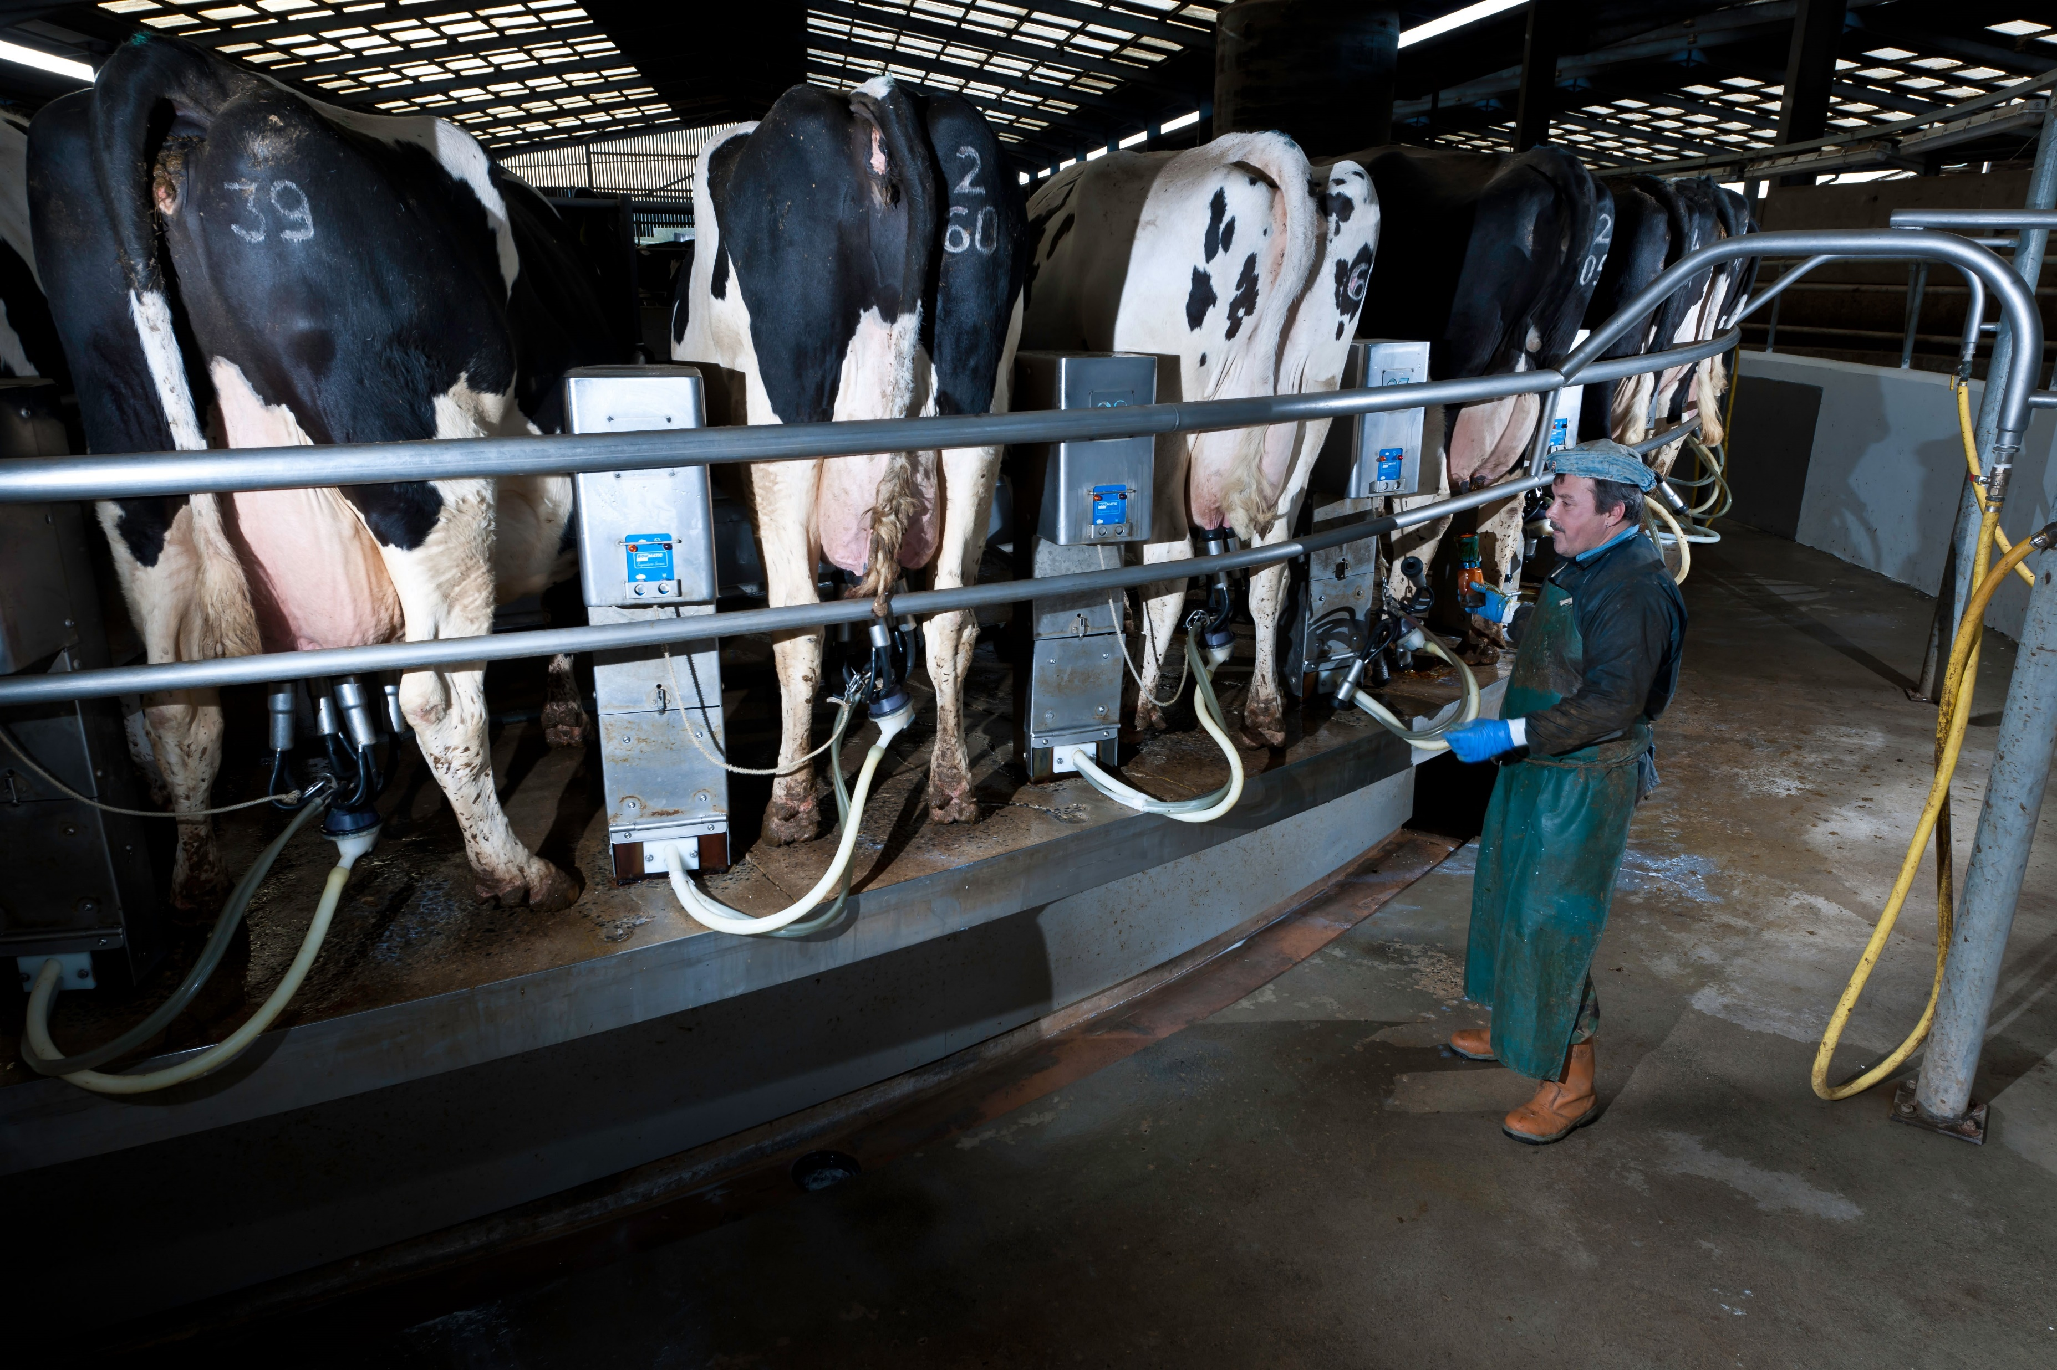
Experience
What experiences are there among us, regarding farm animal welfare?
Terry Mathews / Alamy Stock Photo
Notes:
IMAGE COPYRIGHTED AS NOTED ABOVE – Alamy stock photos in this presentation may only be legally used within CEFAW Education publications.
CEFAW image Rotary milking parlour Terry Mathews / Alamy Stock Photo

Slide 24
Why should Christians be concerned with this topic?
Drawing together our earlier reflections, with the data on farming practices and our own experiences, what conclusions might we draw?
Image by David Mark from Pixabay

Slide 25
Conclusions?
Notes:
This space for class reflections is followed by those from the CEFAW project, but this could be put later, after the CEFAW slides.

Slide 26
The Policy Framework’s conclusions: 1
Christians should be concerned with the welfare of both those working in farming and the animals
Christians should seek to source their food from businesses that promote flourishing of both workers and animals – and be prepared to pay a fair price for it
A move towards buying fewer animal products from higher welfare sources would promote such flourishing
Notes:
See pp34-35 of the report for recommendations to Christian groups

Slide 27
The Policy Framework’s conclusions: 2
Christians should promote changes in treatment of animals:
Reduction of mutilations
Support longer maternal care
Longer life spans
Breeding that does not prioritise production over flourishing
Notes:
See pp34-35 of the report for recommendations to Christian groups

Slide 28
Other sources
Bauckham, Richard (2002) ‘Joining Creation’s Praise of God.’ Ecotheology 7:45-59.
Clough, David L. On Animals: Volume I: Systematic Theology: 1 (London & New York: T&T Clark, 2011)
Clough, David L. On Animals: Volume 2: Theological Ethics: 1 (London & New York: T&T Clark, 2018)
Fretheim, Terence E. (1987) ‘Nature’s Praise of God In The Psalms.’ Ex Auditu 3:16-30.
Notes:
Bauckham, Richard (2002) ‘Joining Creation’s Praise of God.’ Ecotheology 7:45-59.
Clough, David L. On Animals: Volume I: Systematic Theology: 1 (London & New York: T&T Clark, 2011)
https://hub.commonawards.org/blocks/configurable_reports/viewreport.php?id=40&filter_var=9780567171214
Clough, David L. On Animals: Volume 2: Theological Ethics: 1 (London & New York: T&T Clark, 2018)
https://hub.commonawards.org/blocks/configurable_reports/viewreport.php?id=40&filter_var=9780567660886
Fretheim, Terence E. (1987) ‘Nature’s Praise of God In The Psalms.’ Ex Auditu 3:16-30.

